Slide 1
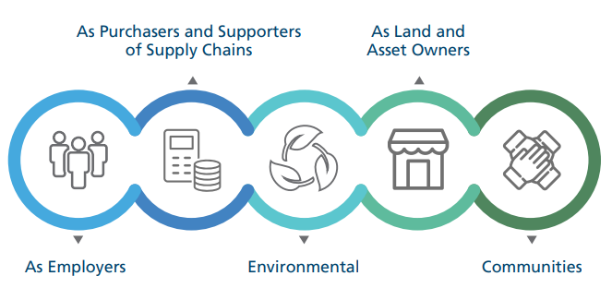
ESNEFT Anchors Dashboard
TOMS
Themes
Outcomes
Measures
Jan 2024

Slide 2
What is an Anchor?
Anchor institutions are large public sector organisations which are rooted in place and connected to their communities, such as universities, local authorities, and hospitals.
Anchors have significant assets and spending power and can consciously use these resources to benefit communities.
As well as providing health services, the NHS can use its resources and influence to maximise its social, economic and environmental impacts (social value) to improve the social determinants of health, health outcomes and reduce health inequalities.
The NHS and wider health and care organisations, working in partnership with communities, local authorities and other public agencies, educational organisations, Voluntary, Community and Social Enterprise (VCSE) organisations and businesses, can make a difference in the following ways:
Widening access to quality work: Being a good employer, paying people the real living wage and creating opportunities for local communities to develop skills and access jobs in health and care.
Purchasing for social benefit: Purchasing supplies and services from organisations which consider their environmental, social and economic impacts
Using buildings and spaces to support communities: Widening access to community spaces, working with partners to support high-quality, affordable housing and supporting the local economy.
Reducing its environmental impact: Taking action to reduce carbon emissions, consumption and reduce waste and protect and enhance the natural environment.
Working closely with local partners: Collaborating with communities to help address local priorities and build on their energy and skills; and work with other anchors and partners to increase and scale impact.
Definition from Health Anchors Learning Network

Slide 3
Updates since last Dashboard
Qualitative information has been fully updated.
Quantitative data for Employers, Purchasing & Environment included in this dashboard are now in line with agreed ICB metrics.
In June ESNEFT contributed to the Essex Anchors Network Progression Framework to map activity taking place across Anchor institutions in Essex.
In July the University College London published an Anchors Toolkit which defines common metrics (see next slide for full details)
In Sept & Oct we worked with the ICB to determine which metrics would be standard in the ICB and partner Dashboards
In Nov ESNEFT completed an initial ICB Dashboard, using previous qualitative and quantitative information, which along with other ICB organisations dashboards will be reviewed at the next ICB Anchor Steering group meeting early in 2024
We have included an updated slide for the Armed Forces activity
We have socialised the Anchor programme with Divisional Management Teams and also at the summer Finance away day.

Slide 4
UCL Partners Anchors Toolkit
The new Measurement Toolkit for Health Anchors was published in July.
Anchor Institutions – UCLPartners
The toolkit provides guidance for local health anchors and their partners to demonstrate the links between their anchor activity and impact and provides support on data and measurement.
The toolkit includes:
A logic model to provide a ‘golden thread’ from anchor activities to impacts
A ‘menu’ of 56 indicators, categorised by:
11 areas of anchor activity
How easy they are to measure
Suitability for regular measurement and
Links to existing measurement frameworks and datasets.
16 examples of anchor measurement in action and 4 longer case studies of anchor measurement approaches 8 underpinning principles for good anchor measurement
Anchor action and its measurement varies significantly by population needs and assets, institutional priorities and existing anchor activity. The toolkit is therefore adaptable to local context and provides options to support improvement

Slide 5
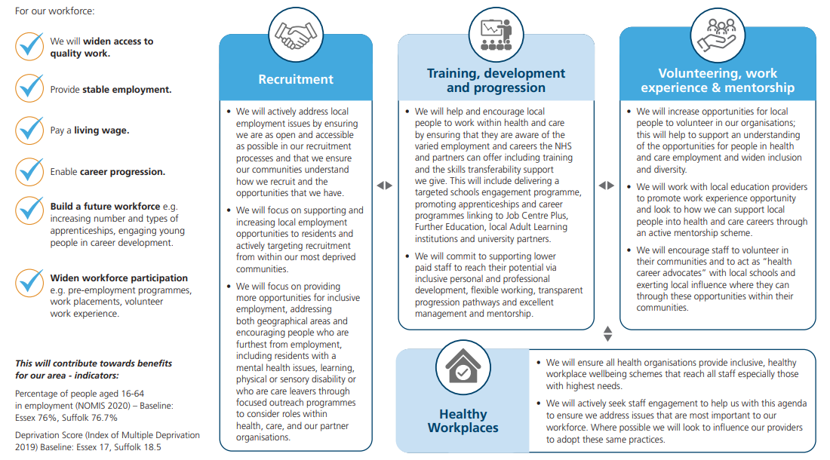
Our commitment as Employers

Slide 6
Our action as Employers
What have we done since the last Dashboard – May 23
We accommodated a total of 694 work experience placements last academic year 22-23 and 157 to date in 23-24.
In addition, we accommodated 64 FE clinical placements for Colchester Institute and Suffolk New College students
To date this academic year 23-24, we have accommodated 18 FE clinical placements for Colchester Institute BTEC Health and Social Care students with a further 16 to commence in February
To date this academic year 23-24, 19 FE clinical placements have been accommodated for Suffolk New College (SNC) T-Level students
In addition, to date we have 6 Special Educational Needs interns who have commenced across sites since September
In May 23, 35 students took part in an Operating Department Practitioner day in-line with the national event. Students were given the incredible opportunity to gain an experience of real-life theatres at Nuffield hospital and a valuable insight into the ODP profession in anaesthetics, surgery and recovery ran by our ESNEFT theatre professionals. We ran a similar day in July where students took part in an open day in the Radiotherapy department at Colchester Hospital. Students participated in an interactive tour of the department learning about pre-treatment, the planning process and witnessed the MRI in action on a medical manikin
Due to the popularity of last year, we ran two ESNEFT Careers Fairs in both Suffolk and Essex in October and November. We again had over 25 different professions represented with in-depth and interactive stations to engage and educate students. Across the 2 events, we had a footfall of 602 students
In September we had the launch event for our Next-Medic programme. 11 Year 9s and 10 Year 12s successfully commenced onto either their 5 or 2 year journey. The day included an introduction to the programme with guest speakers, as well as a tour of the ARU School of Medicine and practical skills stations. The next events will take place in February – in the interim the participants have had the opportunity to attend virtual sessions hosted by 3 Foundation Year 2 Doctors at ESNEFT
In September we collaborated with Ipswich Town FC to visit 3 local Primary schools in Ipswich to teach 150 students of Years 5 and 6 CPR
ESNEFT has continued its success in increasing apprenticeship numbers, with the total number of learners on programme now reaching 396. By the end of March 2024 we are working towards 482 apprentices on programme.
Since apprenticeships were launched 72 standards have been utilised across ESNEFT. Since April 2023 we have increased our offering to include Customer Service Practitioner, Assistant Accountant, Data Technician, Speech and Language Therapist and Senior People Professional
As an ‘Anchor Employer’ ESNEFT has committed to financially supporting the training in healthcare of talent of the local community. Since April 2023 17 employers have benefitted financially through the sharing of our Apprenticeship Levy, supporting 25 apprenticeships.
At present 10% of monthly Apprenticeship Levy expenditure is via gifting levy share transfers.
* Due to launching the new TfC outreach programme and relaunch of work experience post pandemic in August 2022 the figures provided are from Aug 22 – Aug 23 (13 months). Hereafter figures provided will be from Sep-Aug (12 months) in accordance with the majority of students official academic year

Slide 7
Our action as Employers
What are we going to do
The midwifery apprenticeship standard is expected to be available in Sept 2024,we are currently considering as a Trust how we might utilise this.
Outreach initiatives aligned with ICS Pharmacy and Healthcare Science Workforce strategies include –
a Healthcare Science Masterclass in late January for 30 students.
ESNEFT coordinating a work experience programme for community pharmacies, incl. processing applications, and supporting pre-placement checks.
ESNEFT Career Start Programme restarts in Feb 2024 at Col Institute; planning to replicate with Suffolk New College in 2024, focusing on the ODP apprenticeship.
Collaborating with Essex Care Leavers through an MOU, proposing bespoke outreach projects for young people in care and young adults who have been in the care system.
Submitted applications on 30 November to the Public Health Accelerator Fund for two projects:
100 Tendering Apprenticeships" in collaboration with Tendering District Council aims to address health inequalities, creating 100 apprenticeships with £350,000 ESNEFT Apprenticeship Levy. PHAB funding provides a £1,500 employer payment for each apprentice, covering new starter costs.
Tendering Welcome Hubs," warm spaces open all year, designed in collaboration with Col Institute and TDC, address various issues, offering activities related to physical and mental health, access to health services, education, skills, employment, social inclusion, and subsidized/free food. Open to all residents, providing tools for positive changes.
Case Study
ESNEFT are excited to be one of the pilot sites nationally to offer the Medical Apprenticeship in collaboration with Anglia Ruskin University. The offering will not only provide an alternative path into medicine for people who might not have otherwise applied, it will contribute to changing the current doctor demographic to be more representative of their local communities.
Our goal is to make the profession more accessible, as at present there are barriers which hold back talented people from applying. One of the ways these barriers are being removed is having all the tuition fee’s being paid by ESNEFT’s Apprenticeship Levy account. Not only this but candidates will also receive a salary for the full 5 years of study.
In February 2024 we will run a series of Information / Screening events for the general public to learn more about the opportunity and if attendees meet the entry requirements they will be given application links to apply. Commencing with employment with ESNEFT in Summer followed, teaching will commence with ARU in September 2024. This will be amongst the first of its kind in the country, with 20 per year at ESNEFT.

Slide 8
How we are measuring our progress as Employers
Have stable employment in an organisation that is good to work for :
BENEFIT TO PEOPLE | MEASURE | DATA
Have stable employment in an organisation that is good to work for | Sickness absence rate % (NHS Provider Staff Data) - quarterly | 5.1% - Oct 23
 | Leaver rate (%) (NHS Provider staff data) - quarterly | 11.3% - Oct 23
Have equity in employment, opportunity and progression | Relative likelihood of appointment from shortlisting for local and/or target populations (ratio) – annual (workforce race equality standard reporting) | Relative likelihood of White staff being appointed from shortlisting compared to BME staff : 1.25 – 2022 Relative likelihood of Disabled staff being appointed from shortlisting compared to non-disabled staff : 1.24 2022
Have access to training, development and opportunities | Proportion of the apprenticeship levy spent (%) - annual | 47% 2022/23
Have equity in employment, opportunity and progression | Proportion of staff who agree that their organisation acts fairly with regard to career progression/promotion regardless of ethnic background, gender, religion, sexual orientation, disability or age (%) - annual (NHS Staff Survey) | 53.9% (2022)
Have more access to local employment | Proportion of staff in each band and/or staffing group who are local (%) - annual (HR data and Google Maps) | 62% of employees live within 5 miles of work – April 22
Have equity in employment, opportunity and progression | Proportion of staff in each band and/or staffing group from target populations (%) - annual (NHS Provider Staff Data) | See next slide for further details

Slide 9
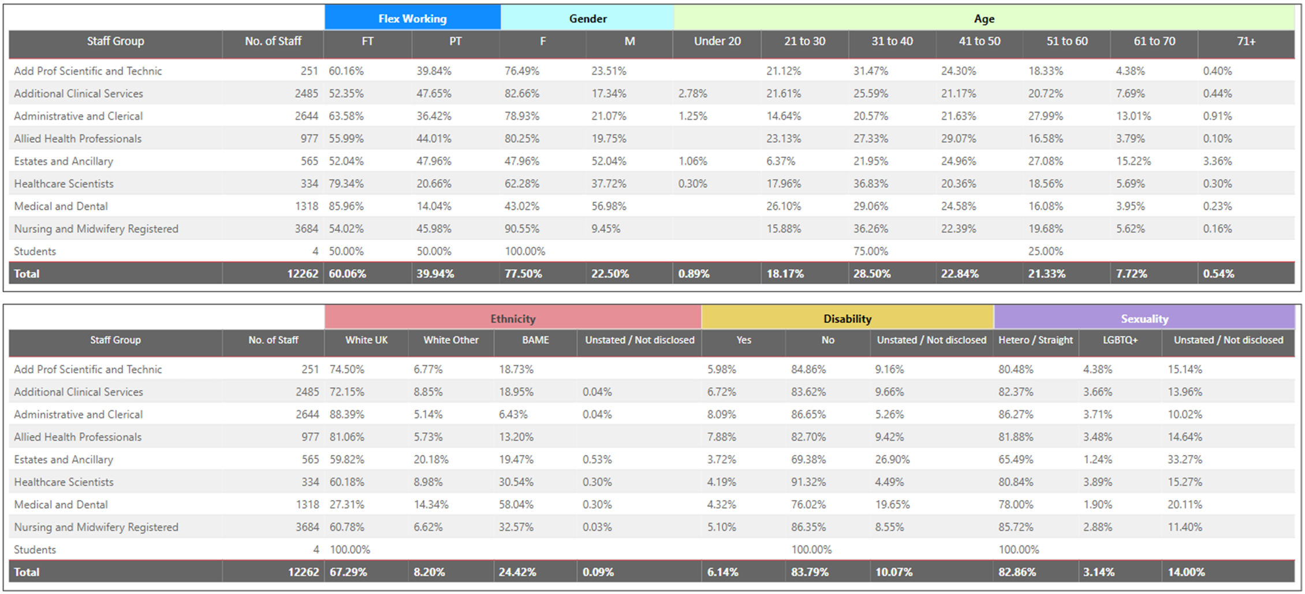
How we are measuring our progress as Employers
Have equity in employment, opportunity and progression :
Movements from last submission : Flexible working has increased by 0.5% for both full time and part time staff, the proportion of staff under 30 has increased by 0.5%, the BAME staff group has increased by 1.7% and staff with a disability has increased by 0.9%.

Slide 10
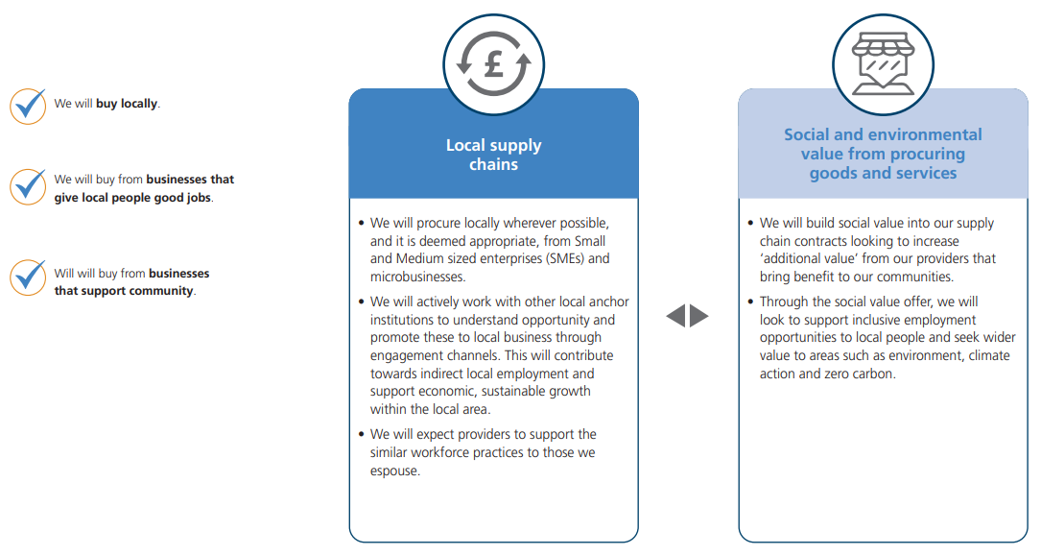
Our commitment as Purchasers

Slide 11
Our action as Purchasers
What have we done last Dashboard – May 23
What are we going to do
Collaborated with West Suffolk for an ICS wide elective Hip and Knee contract
We have entered into 58 contracts which have included 10% Social Value weighting, the total value of contracts is just under £22m.
The Net Zero Supplier Roadmap started in April 2023. This requires that for all new contracts above £5 million per annum suppliers will need to publish a carbon reduction plan
We are looking at how we address the need for the NHS to become more sustainable in the products we consume, including looking at multi-use, re-manufactured and more recyclable products
New rules for the commissioning and purchasing of healthcare services came in to force on 1 Jan 2024, known as the Provider Selection Regime (PSR). The PSR will give ESNEFT the ability to follow a variety of award processes to best select providers of healthcare services and are designed to ensure decisions are made in the best interests of the local population
Case Study - Examples of promoting & delivering Social Value in tenders
Estates Contractor - committed to a donation of £500 to the Trust Hospital Charity fund and also that any vacancies created from the contract would be offered via on a local basis.
Estates Contractor - committed to employ a labourer from the local area for the project and also to sponsor a Trust Hospital charity event and to take part in at least two events.
IT Provider – Demonstrated reduction in the amount of single use plastic and packaging though engagement with manufacturers, they evidenced 0.5m boxes shipped using eco-friendly means since 2022
Scanning Services – Reduction in company mileage costs (87% reduced compared to prior year ) and generated 30% less waste paper in compared to prior year. All paper waste is recycled.

Slide 12
How we are measuring our progress as Purchasers
BENEFIT TO PEOPLE | MEASURE | DATA
Encourage and support local enterprise | Average length of time taken to pay suppliers (days) (finance system) - Quarterly | 27 Days
Spend money locally to boost local employment and economy | Proportion of annual addressable spend that is with local and/or target organisations (%) (finance system) - Quarterly | 34%

Slide 13
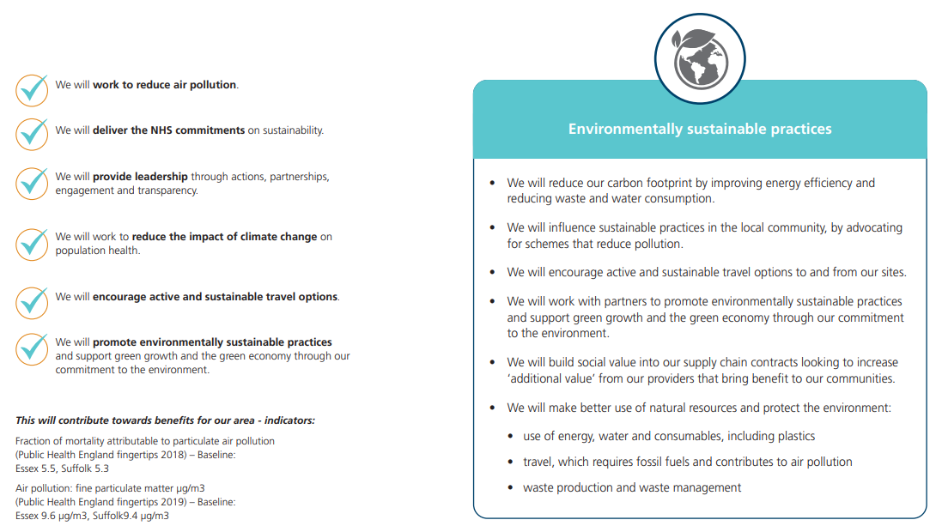
Our commitment to the Environment

Slide 14
Our action to the Environment
What have we done since last Dashboard – May 23
What are we going to do
ESNEFT Green Plan has been updated and is in the process of getting Board approval
Our application to NHS Forest was successful and we have received 120 trees which include Acer
Campestre (Field Maple), Prunus Padus (Bird Cherry) and Sorbus Aucuparia (Rowan) planting on the acute sites has taken place.
Metering Equipment is installed and new supply at COH is live, this will help analyse energy usage
Royal Horticultural Society (RHS) Healing Gardens
Green Plan being presented to Trust Board on 11th January 2024
Detailed action plans to follow the Green Plan
Looking at opportunities for Cycle Repair and Storage facilities.
Redefining the governance structure and reporting of the Sustainability Steering Group
Colchester Hospital Electrical Infrastructure Upgrade - Thor Five Project is to extend the new hospital HV supply to the Main Hospital sub-stations to replace the existing UKPN supplies - now out to Tender
All new builds will be fitted with Solar Panels
Case Study
The Royal Horticultural Society (RHS) is the UK’s leading gardening charity. Healing Gardens aim to enrich everyone’s life through plants, and make the UK a greener and more beautiful place. Scientific research is now backing up what garden designers have long understood about specific garden elements that encourage recovery from physical and mental fatigue. Evolutionary biology even influences our responses to landscapes. People prefer views that are reminiscent of the savannas where humans evolved. Throughout human history, trees and water have signalled an oasis, while flowering plants have been a sign of possible food.
Planning decision is due imminently and we hope to start creating the healing gardens in 2024.

Slide 15
How we are measuring our progress to the Environment
BENEFIT TO PEOPLE | MEASURE | DATA
Being served by organisations that enable and support use of active and sustainable travel options | Proportion of on-site car parking spaces that are electric vehicle charging stations (%) (Green Plan / ERIC) - annual | 12 spaces – as at Nov 23
Have cleaner air | Total carbon equivalent emissions resulting from building energy use (ktCO2e) (Green Plan / ERIC) - annual | Carbon equivalent energy emissions Gas = 7 KtCO2e Carbon equivalent energy emissions Electricity = 9 KtCO2e Carbon equivalent energy emissions Waste = 1 KtCO2e Carbon equivalent energy emissions Hot water & Steam = 4 KtCO2e
Being served by organisations that promote environmentally sustainable products and practices | If a waste reuse scheme exists, carbon savings from this scheme (CO2e tonnes) (Green Plan / ERIC) - annual | Furniture reuse has saved 18.3t CO2e
Have cleaner air | Proportion of fleet vehicles that are LEV (%) (Green Plan / ERIC) - annual | TBA
Have cleaner air | Carbon savings from investment in energy efficient schemes (CO2e tonnes (Green Plan / ERIC) - annual | 350 (CO2e (tonnes)) 22/23

Slide 16
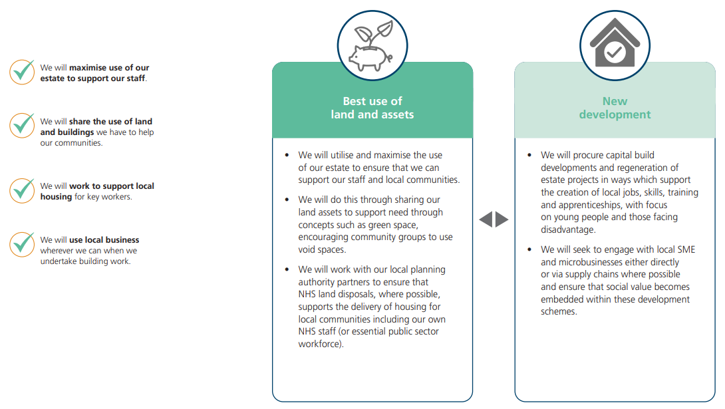
Our commitment as Land and Asset Owners

Slide 17
Our action as Land and Assets Owners
What have we done since last Dashboard – May 23
What are we going to do
Clacton Community Diagnostic Centre (CDC) Phase 1 & 2 are complete – Delivery of CT, MRI, Xray, Ultrasound, Cardio-Respiratory and Blood Testing.
5 years after handing over vacant possession the planning for ECH has been approved and a contractor to develop the site is currently being appointed.
Child Health Phase 2 handed over in December 2023
Tier Scooter Hub scheme – Colchester Hospital
Engagement with local councils – Climate Summit
The Essex and Suffolk Elective Orthopaedic Centre (ESEOC) building work continues and due for completion spring 2024
Outpatient Endoscopy Unit Colchester Hospital
Clacton Community Diagnostic Centre (CDC) Phase 3 due to open January 2024 for the delivery of Endoscopy
Ipswich North End Occupation Review Complete – strategy paper currently in draft stage.
Child Health Phase 3 due to commence January 2024
Clacton Star Business case submitted to regional and national NHSE for approval
Case Study
The Suffolk Climate Change Partnership (SCCP) consists of all of Suffolk’s Local Authorities. Since 2009 they have been working with other organisations locally including Groundwork East, the Environment Agency and the University of Suffolk. They have a shared interest in supporting Suffolk’s communities, businesses and residents to reduce their carbon emissions, realise the economic benefits of reducing energy consumption and adapt to the future impacts of climate change.
SCCP’s vision is for Suffolk to be an exemplar in tackling climate change and protecting and enhancing its natural environment and to be the county with the greatest reduction in carbon emissions.
In 2019 SCCP’s Local Authority members each declared a ‘climate emergency’. As part of this, they are working together with partners across the county and region towards the aspiration of making the county of Suffolk carbon neutral by 2030.
The Suffolk Climate Emergency Plan was agreed by Suffolk’s Public Sector Leaders and supports their commitment to addressing the urgent need to deal with the climate emergency.
SCCP are proud to be members of Fit for the Future, a thriving sustainability network of more than 100 organisations from the not-for-profit sector and beyond. As a collective with similar challenges, Fit for the Future members are collaborating and innovating to find practical solution to the impacts of climate-change.

Slide 18
Our commitment to our Communities

Slide 19
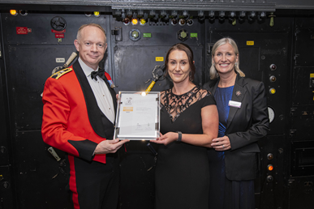
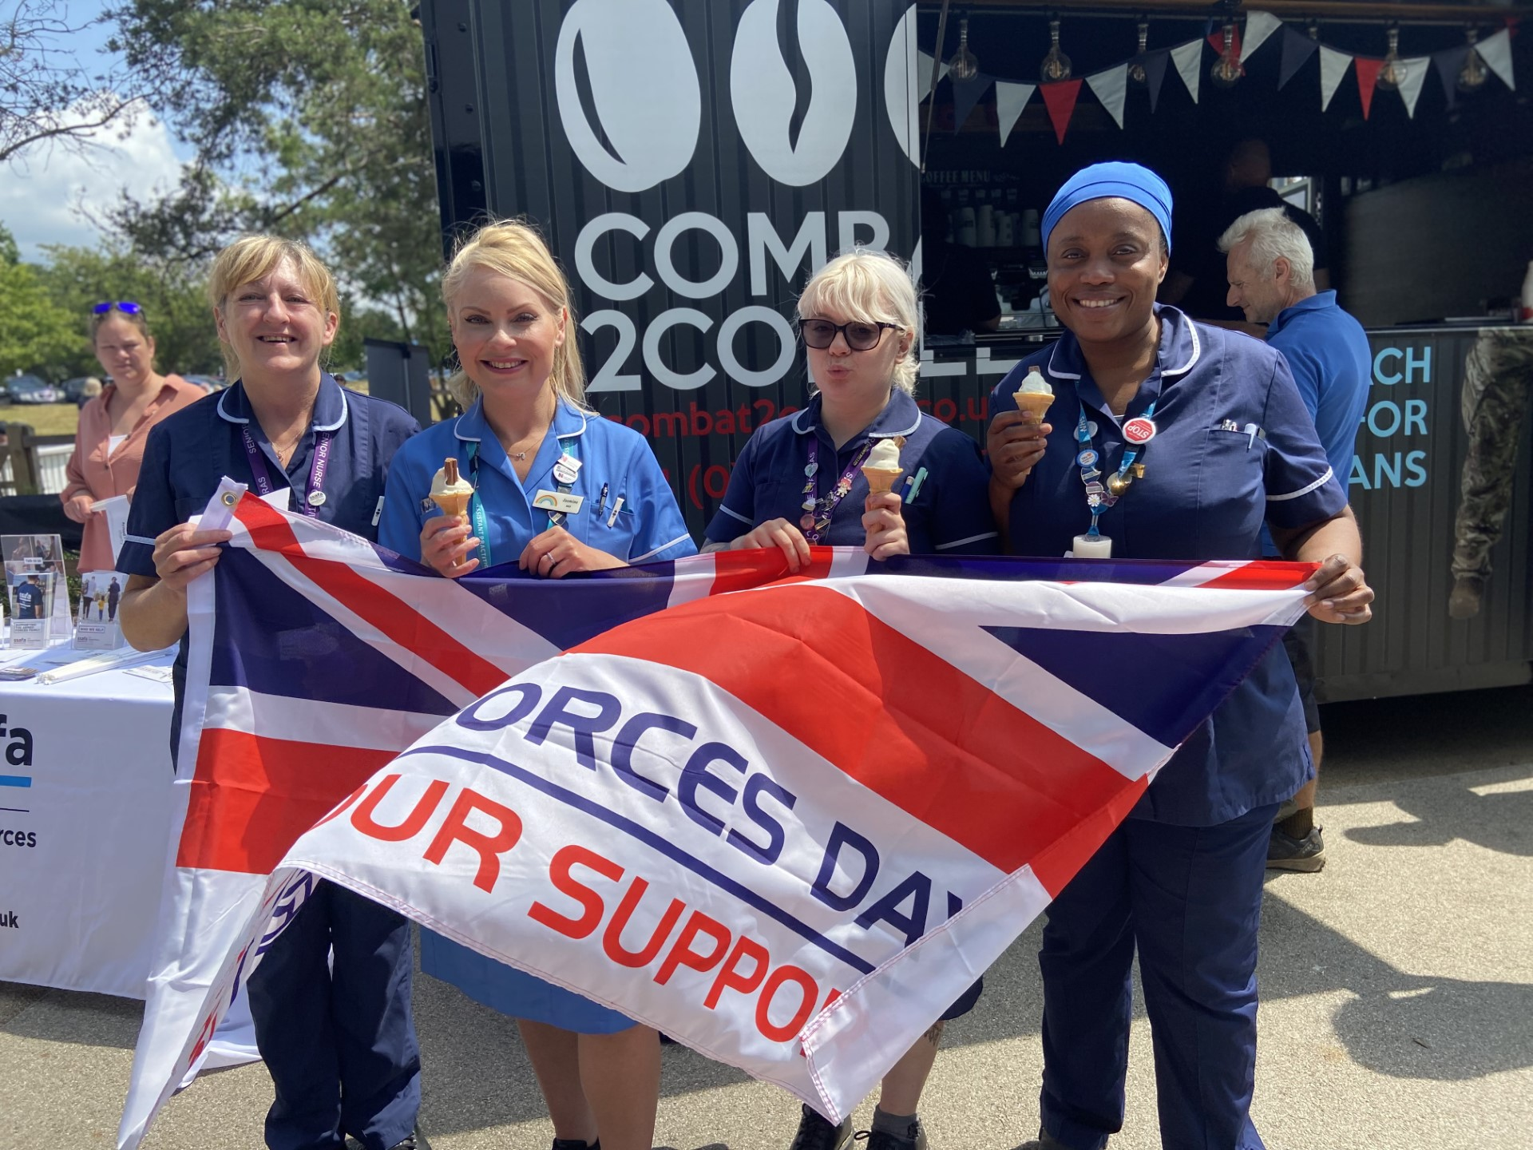
Our commitment to the Armed Forces Community
What have we done since our last dashboard.
We have continued our collective ambition in growing armed forces support in our communities. As part of this, we have celebrated / commemorated key events such as:
Armed Forces Week
Reserve Day
Act of Remembrance
In July 23 ESNEFT were delighted to receive amazing news! We were recognised for our work supporting the armed forces community through the Defence Employer Recognition Scheme ‘Gold’ Award
In September 23, we had the honour and privilege to accept our Defence Employer Recognition Scheme ‘Gold’ award at the Churchill War Rooms in London. We celebrated the evening alongside eleven other successful organisations across East Anglia
In December 23, we commissioned Combat 2 Coffee (C2C) to deliver festive drinks to all staff members. The event took place over a two week period covering thirteen ESNEFT sites. Once again this was a valued opportunity for us to work in partnership with local providers – in turn increasing awareness of the services and support available to members of our armed forces community.

Slide 20
Our action to our Communities
What have we done since last Dashboard – May 23
What are we going to do
Clacton CDC Training Academy: Formal employment support for past candidates concluded on 28th April 2023. To date, 95 jobs and 130 positive outcomes have been secured out of 222 participants.
Armed Forces Employment Programme: The programme has concluded with a total engagement of 6 candidates. Six have completed the program, 3 are now employed, and 4 have been referred to further learning.
General Practice: Total engagement stands at 6, with 4 completed, 1 in employment, and 1 referred to further training.
Ipswich Community Training Programme: The last cohort completed the programme on 6th December 2023. Out of 84 individuals interviewed, 44 completed the programme, 14 are now employed, and 28 have been referred to further training.
Looking towards later in 2023/24, we are exploring options to open a further two Training Academies, with one being hosted by another Trust in our ICB footprint.
Case Study
After a successful bid for NHS England’s WDES funding, and in partnership with Essex Cares Ltd, we are laying the groundwork for a new scheme of work that aims to remove barriers to gaining employment at ESNEFT for people with learning disabilities. The programme will maintain a competitive interview process, while ensuring that all reasonable adjustments are facilitated from the moment the job advert goes live, rather than on commencement of employment.
In partnership with ARU, we are looking to unlock careers in medicine for students from disadvantaged backgrounds by building a 5-year “NextMedic” programme open to students in Year 9. On successful completion of the programme students will have the opportunity to apply to medical schools and where applicable will be made a lower conditional offer. To compliment this, we are also in discussions with ARU regarding the launch of Medical Doctor Degree apprenticeships.

